Slide 1
Respelling in Text Messages
💬
💬
💬
💬
💬
💬
💬
黄士慧 虞杨杰 宁若汐
💬
💬
💬
💬
💬

Slide 2
OUTLINE
💬
Literature Review
Classification & Examples of Respelling
Further Discussion
💬
💬

Slide 3
Part 1 Introduction

Slide 4
Text messages
Def: an electronic message sent over a cellular network from one cell phone to another by typing words, often in shortened form, as “l8t” for “late,” on the phone's numeric keypad.

Slide 5
Text messages
Def: an electronic message sent over a cellular network from one cell phone to another by typing words, often in shortened form, as “l8t” for “late,” on the phone's numeric or QWERTY keypad.
Spelling is important to text messages!

Slide 6
How is spelling meaningful?
It is meaningful because the way we choose to spell words contributes to the effect that a text message has and what the text message says about the person who sent it.
In other words, how we spell contributes to our portrayal of social identities, as we choose to express them through text messaging.

Slide 7
Abbreviations in text messages
“Hi NAME219 hope unis ok&u’r feelin gud Hows it bin wiv NAME227 since u got bac? Gud news bout the playscheme Lookin4ward 2seein u soon hav missd u lotsa love NAME330”

Slide 8
Abbreviations in text messages
although 82% of the 19-year-old university students participating in their study claimed to use ‘textisms’, they found only an average of 3 per text message (which they describe as 20% of message content).
Thurlow and Brown (2003)
the value placed on text messages by young people can depend on the language used, and abbreviating to avoid sending more than one message can in fact lower their value.
Taylor and Harper (2003)

Slide 9
Abbreviations in text messages
most textisms are ‘semantically recoverable’, that is, they can be understood in (or ‘recovered’ from) context.
Thurlow and Brown (2003, p. 15)

Slide 10
Motivation for respellings:
1 ‘brevity and speed’ (seen in lexical abbreviation including letter-number homophones; and the minimal use of capitalization, punctuation and spacing);
2 ‘paralinguistic restitution’ (such as the use of capitals to indicate emphasis or loudness, or multiple punctuation, which compensate for the lack of such features as stress and intonation)
3 ‘phonological approximation’ (i.e. often playful attempts to capture informal speech such as <ya> or <nope>).

Slide 11
A sociocultural model of orthography
Right/wrong
adhering to the correct model or diverging from it, both carry social meaning – it says something about who you are and how society sees you.
The significance and status of orthography and spelling can only be appreciated when its context is taken into account.

Slide 12
Orthography and spelling
Orthography refers to the conventions of a particular written language, which determines possible letter-sequences and the sounds that written letters represent.
<sch>-<ng>
<oo>-<uu>
Spelling is the application of these orthographic principles to particular words.
<gudz>-<goods>

Slide 13
Part 2 Classification & Examples of Respelling

Slide 14
Classification of Respelling
Letter/Number Homophones: use a letter or number to represent a word or part thereof
cu l8r: see you later
wuu2: what you up to
ne1: anyone
BCNU: be seeing you

Slide 15
Classification of Respelling
2. Shortenings: words with missing end letter
Contractions: words with omitted middle letters, uauslly vowels; short forms of words
Clippings: g-clippings and other clippings
sun: Sunday
feb: February
txt: text
hmwk: homework
goin: going
wil: will
hav: have

Slide 16
Classification of Respelling
3. Initialisms: shortening words to their initial letters
omg: oh my god
ttyl: talk to you later
gg: good game
jk: just kidding
idk: I don’t know

Slide 17
Classification of Respelling
4. Non-Conventional Spellings: follows letter-sound correspondences in a language
Accent Stylizations: words spelled in accordance with informal/regional speech
sum: some
thanx: thanks
wanna: want to
gonna: going to
dat: that

Slide 18
Classification of Respelling
5. Other Forms: onomatopoeic spellings, omitted apostrophes
haha
zzzz
cant: can’t
im: I’m

Slide 19
Methodology
1. Letter Substitution
vowels:
ye: you
gud: good
ur: your
nite: night
consonants:
thanx: thanks
fone: phone
n: and
v: very
numbers:
2nite: tonight
4: for
l8r: later
gr8: great

Slide 20
Methodology
2. Letter Omittion
vowels:
gd: good
frm: from
plz: please
thx: thanks
consonants:
tomoro: tomorrow
jus: just
ello: hello
wat: what
syllables:
tomo: tomorrow
bout: about

Slide 21
Part 3 Further Discussions

Slide 22
av (8), hve (6), ave (5), hav (106)
gud (40), gd (25), goodo (3)
jus (18), jst (6)
tomoz (9), tomorro (6), tomorow (4), tomora (3), tomo (361), morrow (6),
mora (1), tom (24), 2mora (14), tomoro (10), 2morrow (9), tmw (9), 2morow (4), 2morro (4), 2mrrw (4), 2moz (3), 2mrw (2), amoro (2), 2moro (42)
wot (148), wat (37)
2nite (45), tonite (10), 2night (12), 2nigt (3)
thanx (32), thx (5), tank (2), sanks (2), thnx (2), thks (1), thanxs (1), tnx (2)
cud (48), cld (19)
luv (46), lv (4), lov (4)
wud (38), wld (22)
cos (226), coz (24), cause (4), cuz (3), cs (2), cus (2), cz (2)
pleasey (4), plez (3), pls (35), plse (3), plz (4), pse (2) gunna (11), gona (6)
sth (9), somethin (8), summort (3), sumfing (2), summat (2), summing (2)
msg (7), mess (8)
d (21), da (6), th (8), te (2), ze (2)
n (182), an (19)
havin (24), avin (6)
mornin (23), morn (18)
l8r (20), lata (5), l8er (2)
mite (9), myt (6)

Slide 23
Classification of Respelling
The respelling represents the colloquial contraction:
Yes: <ya>, <ye> or <yer>
Having: <havin> (where the <g> is dropped) or <avin>

Slide 24
Classification of Respelling
2. Respellings of something show several regional pronunciations:
Something:
<summort>, <sumfing>, <summat> and <summing>.

Slide 25
Classification of Respelling
3. Contrasting forms of eye dialect
Later: <l8r> and <lata>
Might: <mite> and <myt>

Slide 26
Classification of Respelling
4. Reducing the number of characters used, depending perhaps on how much they wish to abbreviate:
Thursday: <thurs> or <thu>
Please: <pls>, <plse> or <pse>

Slide 27
Classification of Respelling
5. The choice between clipping or consonant writing in some examples may depend on texters’ use of predictive texting.
Back：<bac> or <bk>
Give: <giv> or <gv>
Have: <hav> , <hve> or <av>
Tomorrow : <tomo> or <tmw>

Slide 28
Textism
What principles do message texts follow?

Slide 29
2 observations of principles
1. Most spelling variation in CorTxt follows or extends English orthographic principles; and that it thus reflects historical and current spelling practices.

Slide 30
2 observations of principles
2. As in other attempts to reflect spoken or regional pronunciations, colloquial contractions and respellings are likely to fulfil an indexical function and to create and sustain an arena for participant relationships which, as in spoken interaction, are informal and intimate

Slide 31
Principle of Textism in Conclusion:
Texters can express attitudes and emotions, define relationships and construct texting identities simply through the choices they make when spelling.

Slide 32


Notes on Method
Tools:
WordSmith Wordlist
AntConc

Slide 33
Notes on Method
Suggestions:
1. We can work on small number of text messages.
2. These cannot be handled simply by looking at a frequency list but must be checked through sorting concordance lines, and adjusted manually.
3. Respellings proved difficult to identify and label.

Slide 34
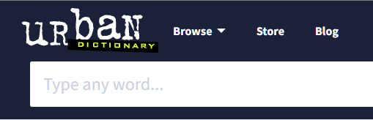
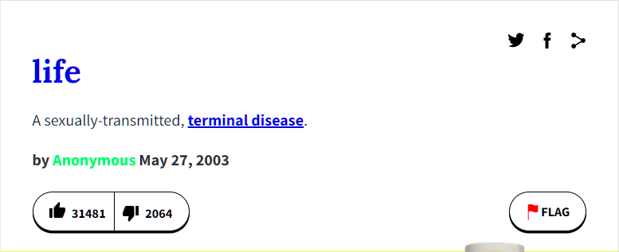
Corpus
Urban Dictionary, December 23: ta ta for now

